Slide 1

Exploring genome-wide organization of chromatin structure by ChIP-seq
Class IV, 2/15/2018
Alon Goren
Department of Medicine,
UCSD

Slide 2
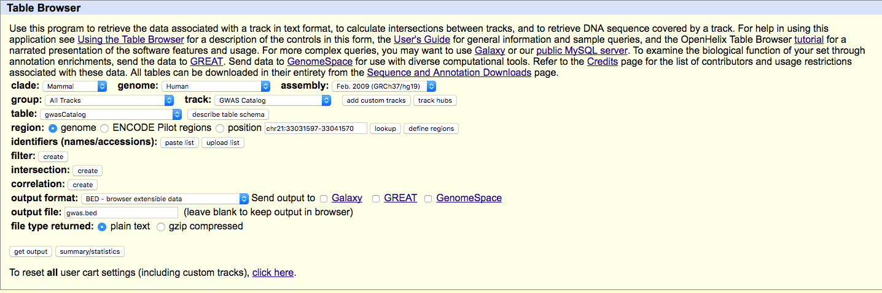
UCSC Genome Browser’s Table Browser
http://genome.ucsc.edu/cgi-bin/hgTables?command=start

Slide 3
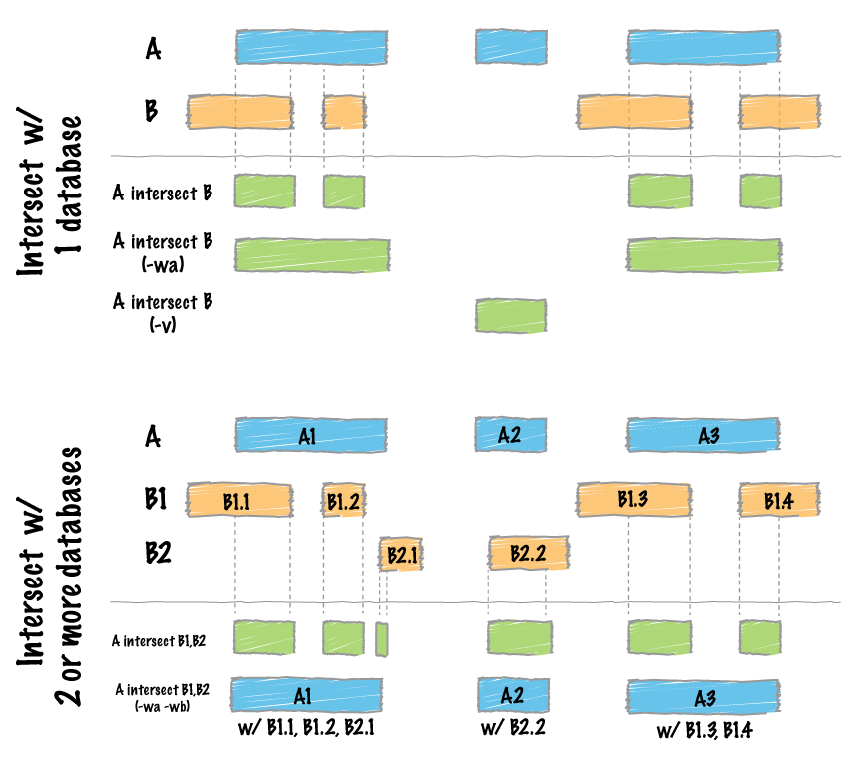
bedtools “intersect”

Slide 4
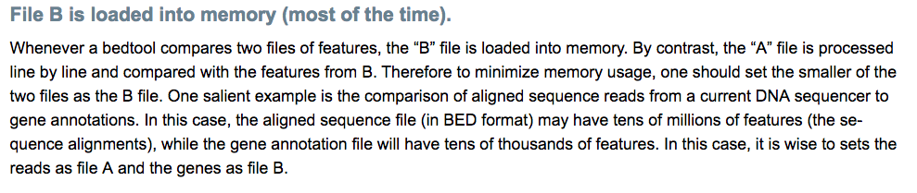
bedtools “intersect”

Slide 5
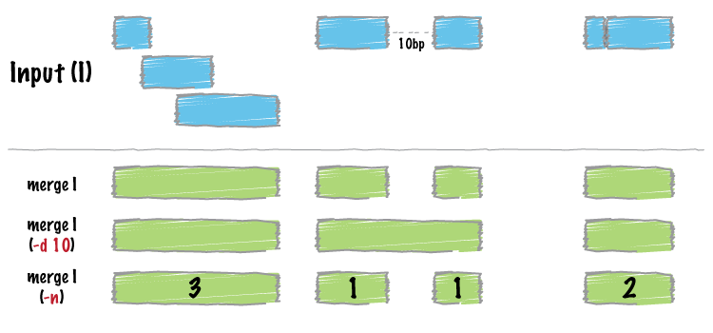
bedtools “merge”

Slide 6
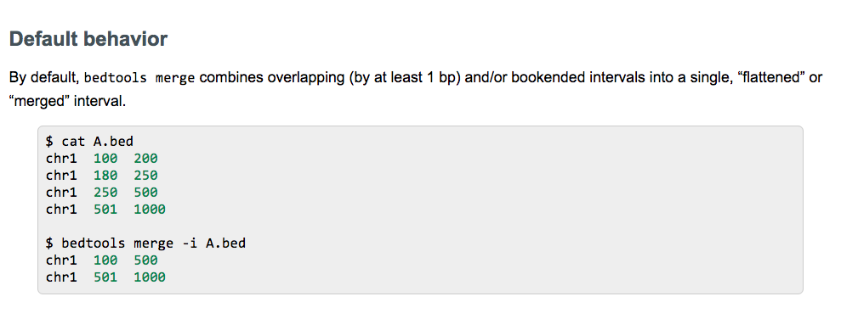
bedtools “merge”

Slide 7
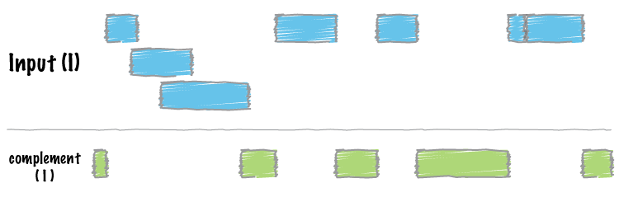
bedtools “complement”

Slide 8
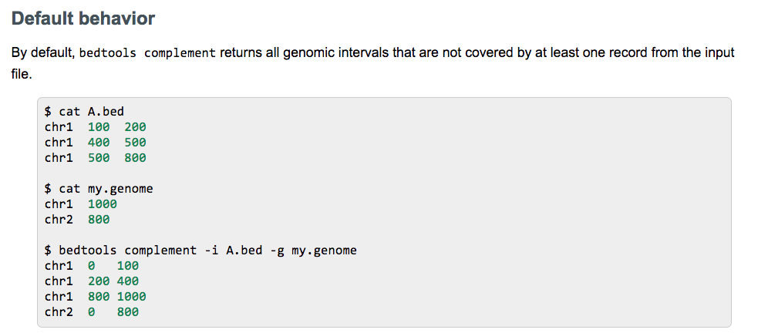
bedtools “complement”

Slide 9
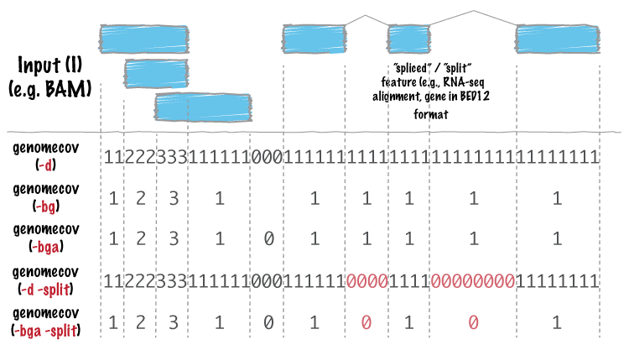
bedtools “genomecov”

Slide 10
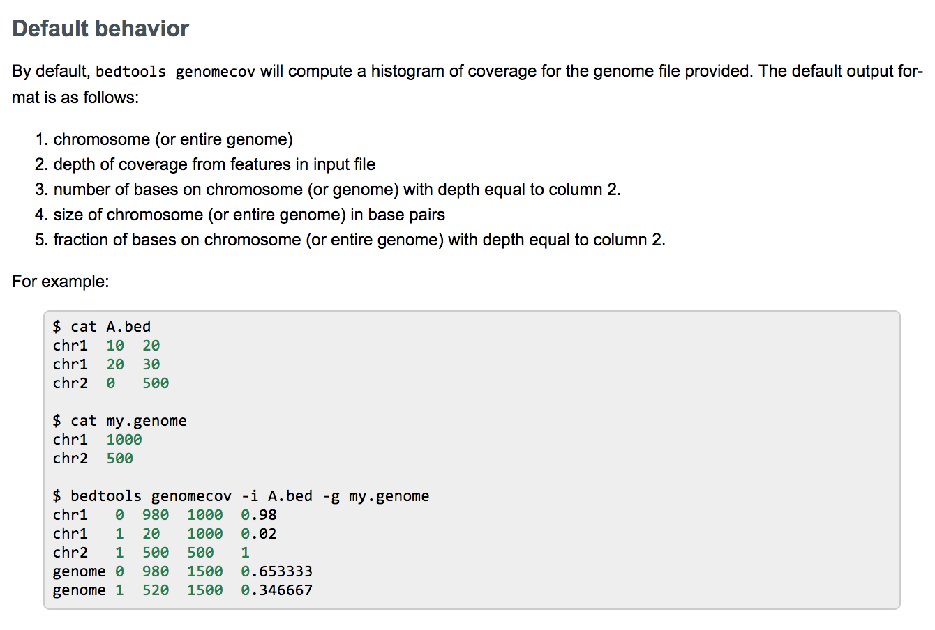
bedtools “genomecov”
http://bedtools.readthedocs.io/en/latest/content/tools/genomecov.html

Slide 11
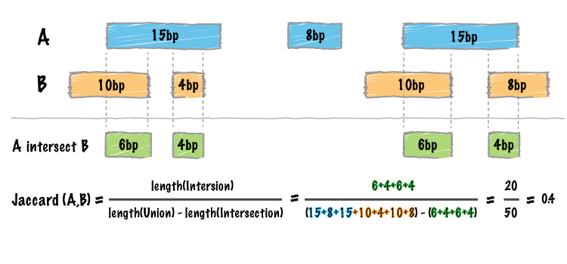
bedtools “jaccard”

Slide 12
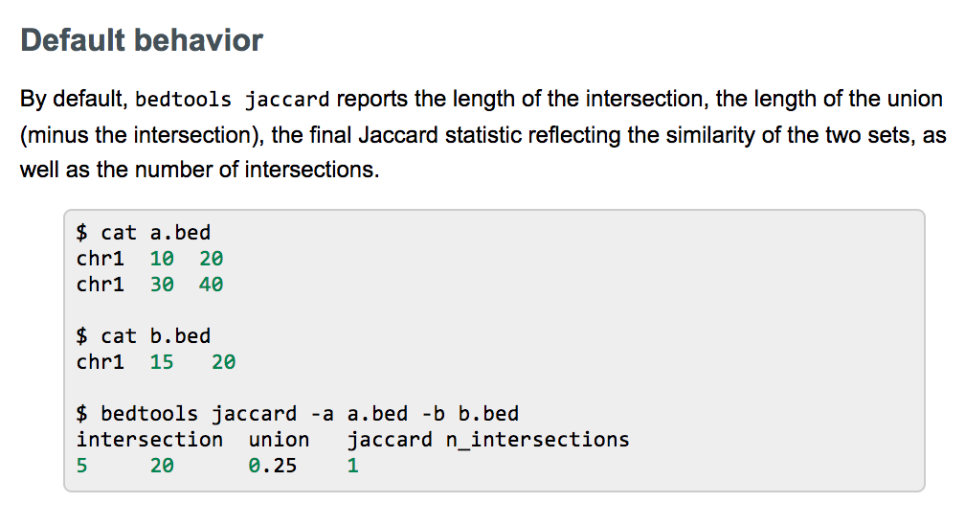
bedtools “jaccard”

Slide 13
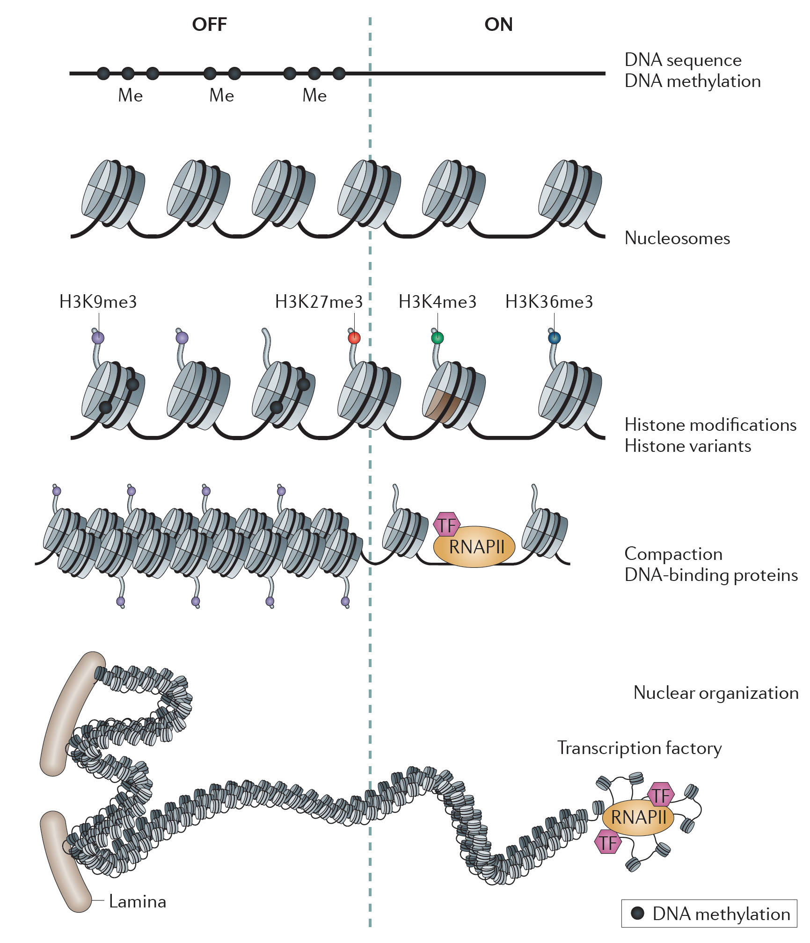
Layers of chromatin organization:
Zhou, Goren & Bernstein Nature Reviews Genetics 2010

Slide 14
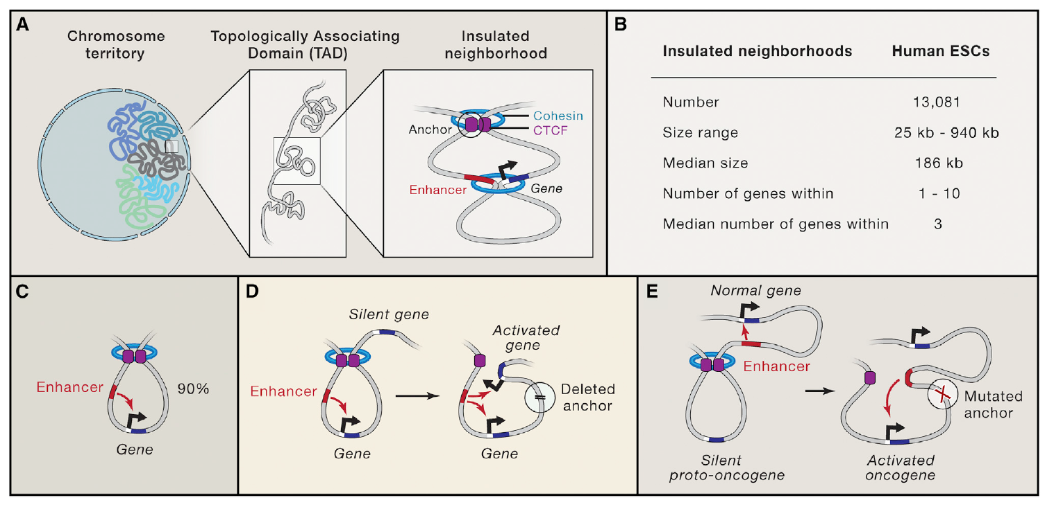
Some background about CTCF
Hnisz, Day & Young Cell, 2016

Slide 15
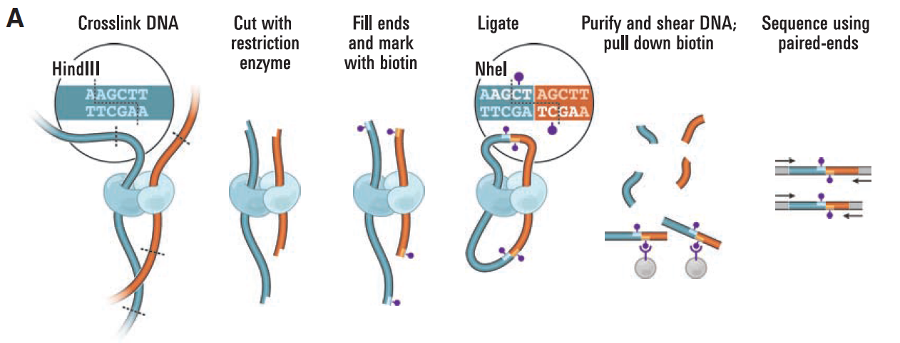
Hi-C method overview
Lieberman Aiden & van Berkum et al. Science 2009

Slide 16
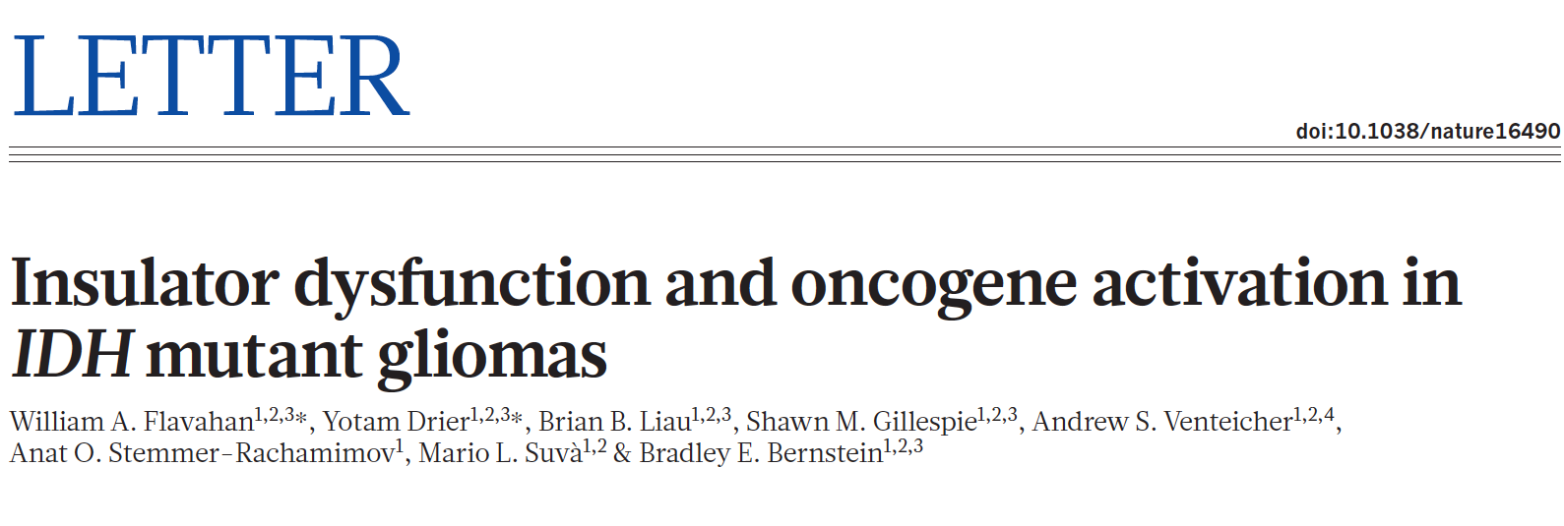

Slide 17
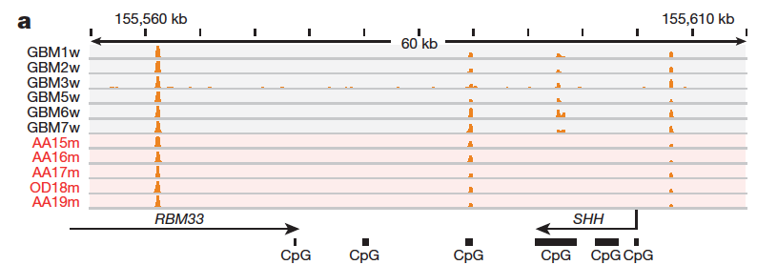
CTCF binding and gene insulation compromised in IDH
mutant gliomas.

Slide 18
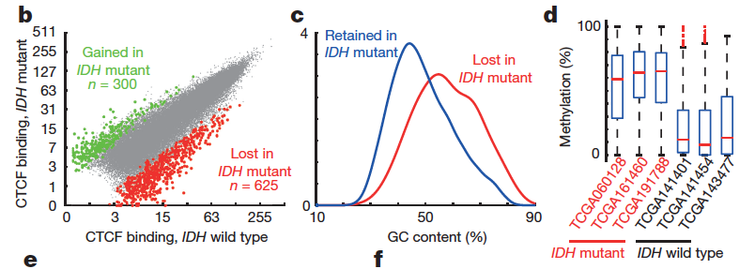
CTCF binding and gene insulation compromised in IDH
mutant gliomas.

Slide 19
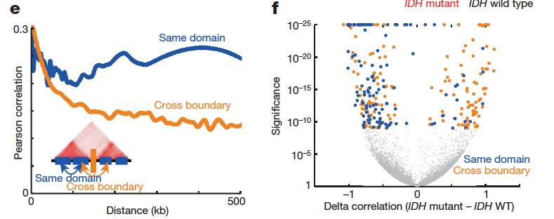
CTCF binding and gene insulation compromised in IDH
mutant gliomas.

Slide 20
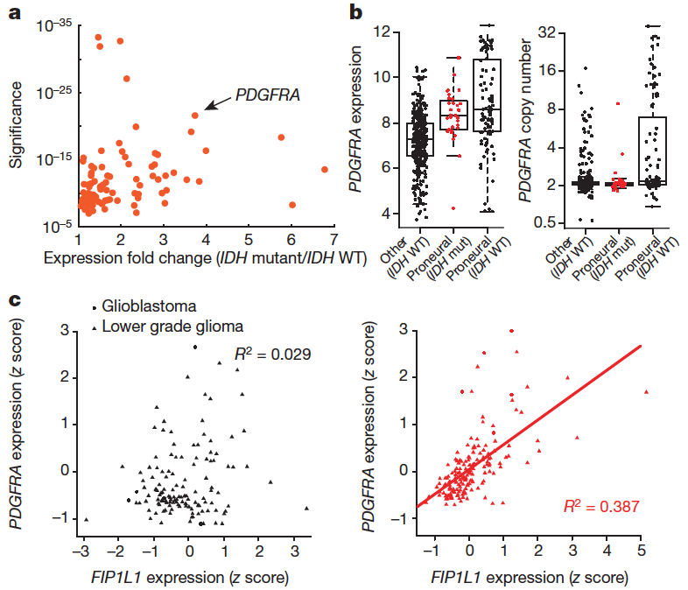
Topological domain boundaries disrupted in IDH mutant
gliomas

Slide 21
Topological domain boundaries disrupted in IDH mutant
gliomas

Slide 22
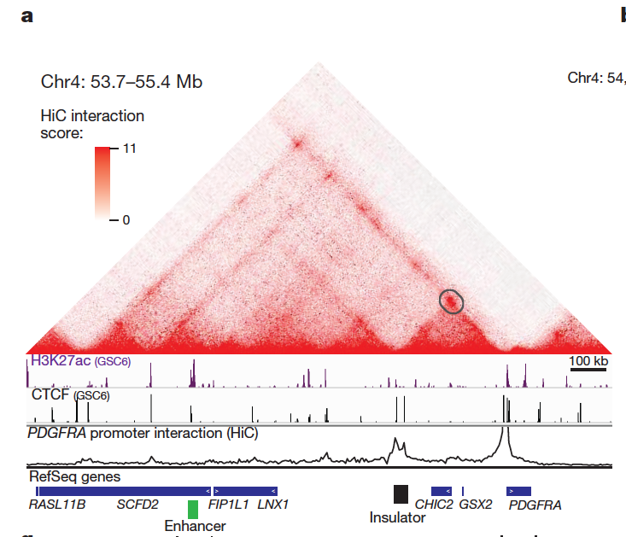
Insulator loss allows PDGFRA to interact with a constitutive enhancer

Slide 23
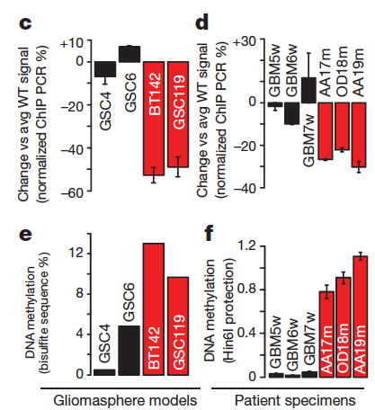
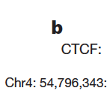
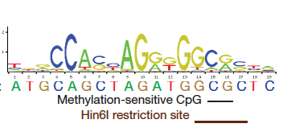
Insulator loss allows PDGFRA to interact with a constitutive enhancer

Slide 24
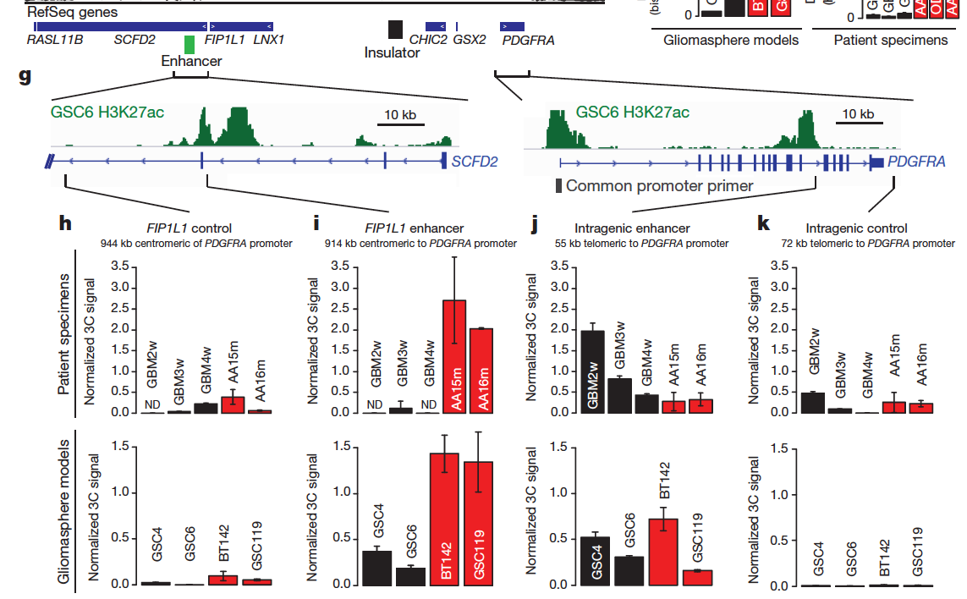
Insulator loss allows PDGFRA to interact with a constitutive enhancer

Slide 25
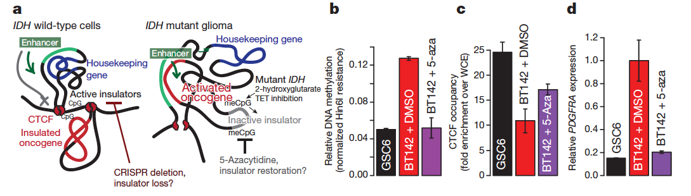
Boundary methylation and CTCF occupancy affect PDGFRA
expression and proliferation.

Slide 26
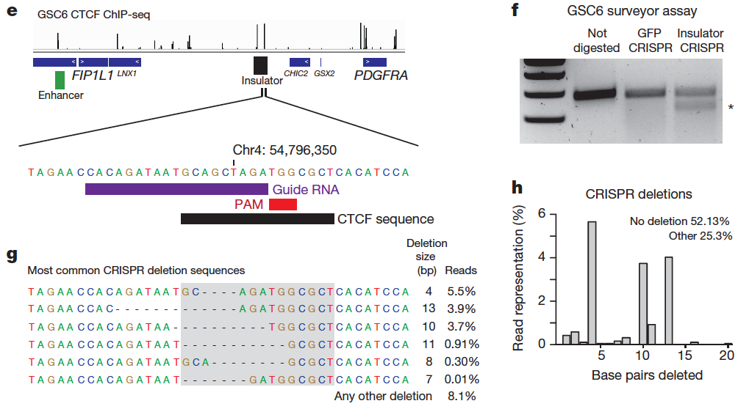
Boundary methylation and CTCF occupancy affect PDGFRA
expression and proliferation.

Slide 27
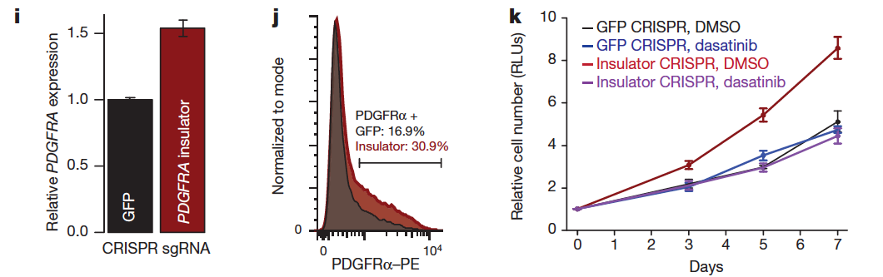
Boundary methylation and CTCF occupancy affect PDGFRA
expression and proliferation.

Slide 28
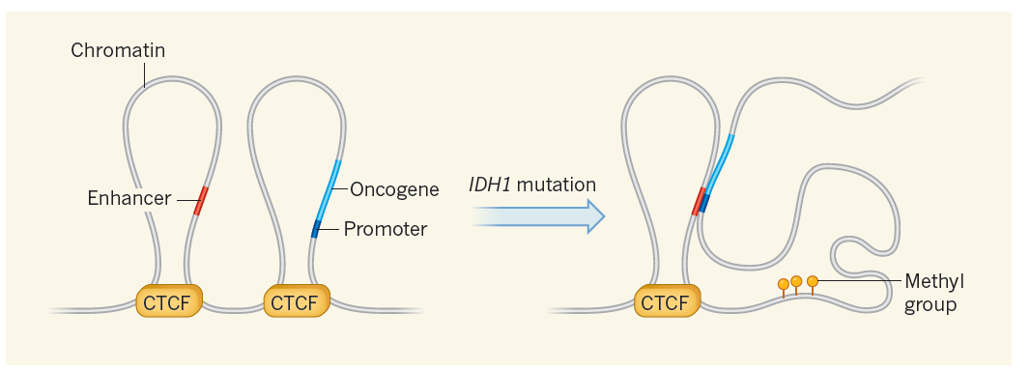
Summary
Grimmer & Costello Nature 2016

Slide 29
Extras

Slide 30
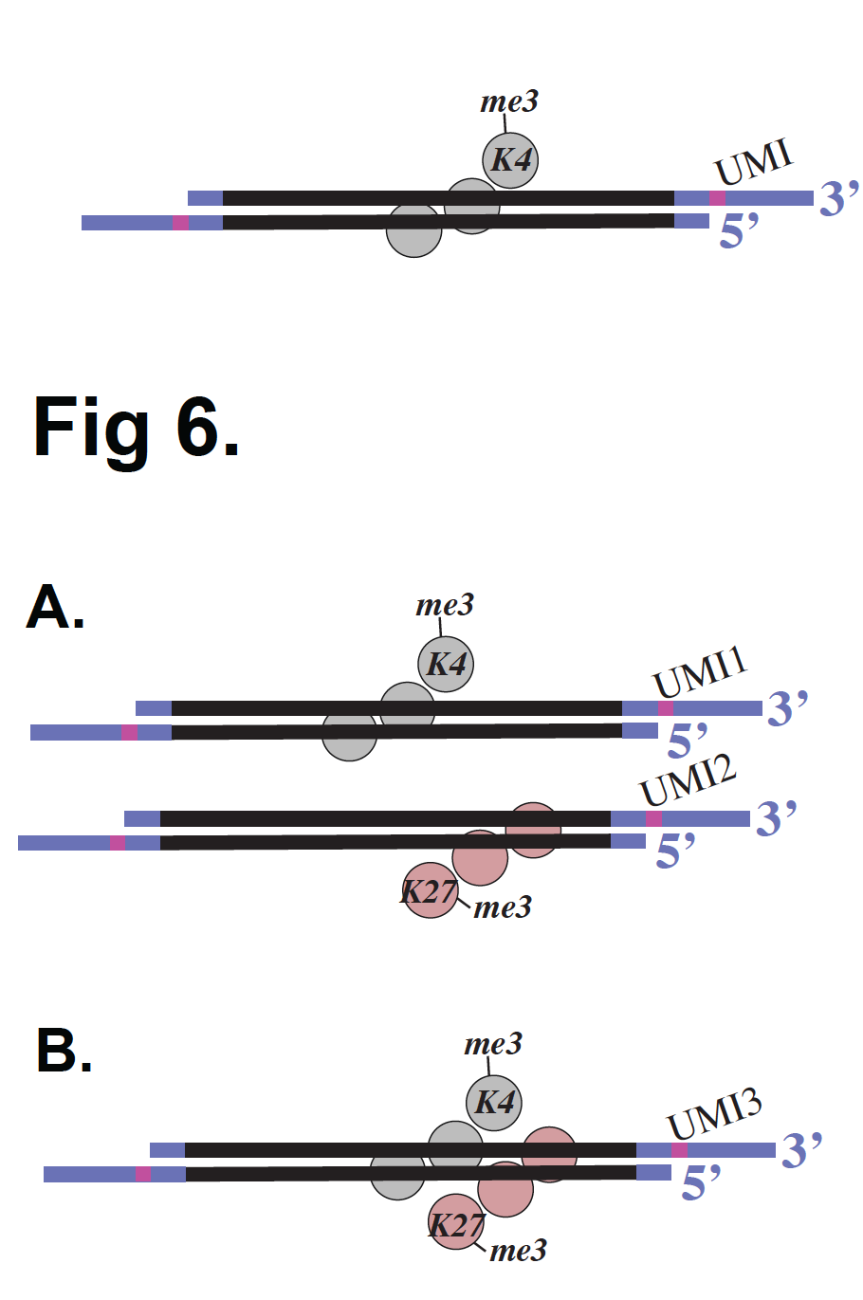
Internal Standards

Slide 31
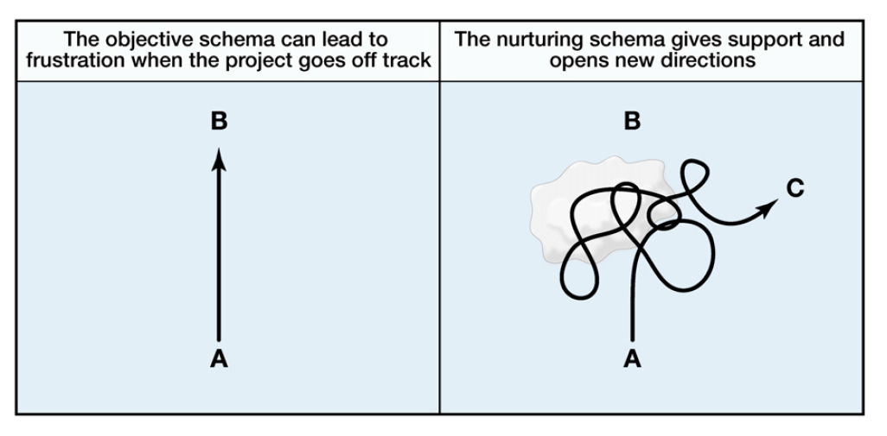
Nurturing (Uri Alon)
Alon, Mol Cell 2009

